Slide 1
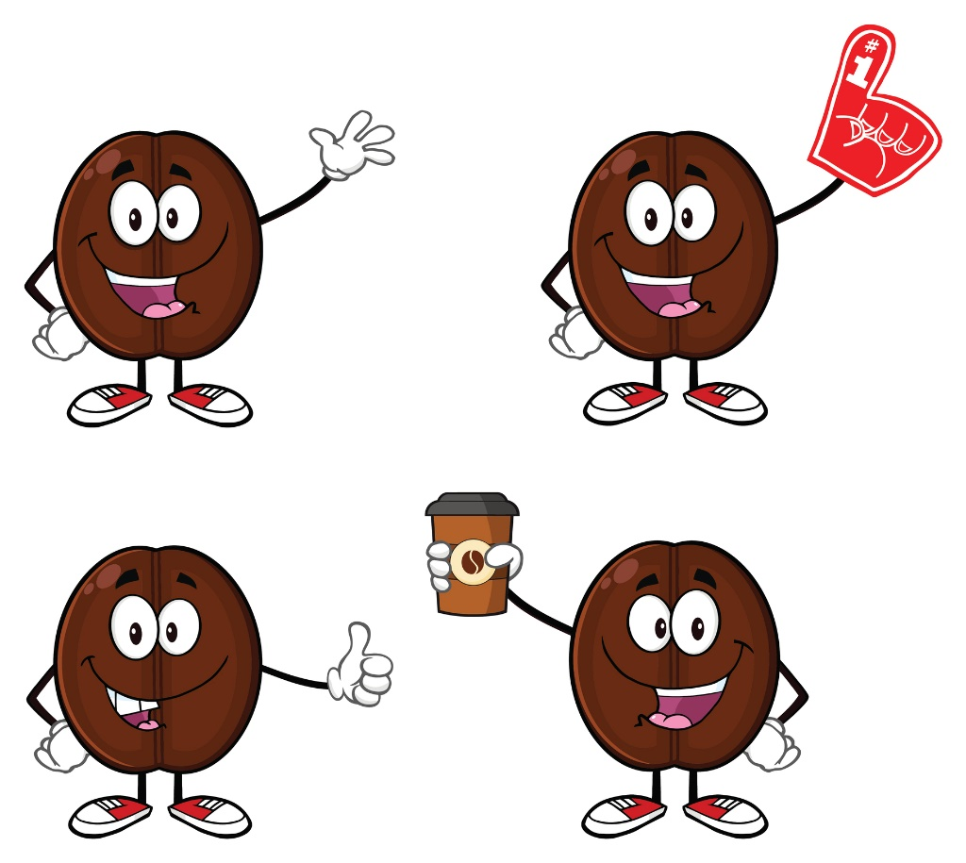
KoffeeBan Game
The KoffeeBan Company
Kanban simulation

Slide 2

Jazz hands
For a few early rounds in the game, I will walk you through steps by steps on how to play
Most of the time it went out of control
When I do jazz hands, please stop talking and also do jazz hands

Slide 3



Scenario – KoffeeBan Company
You are working on website development for The KoffeeBan Company that sells coffee beans from all continents around the world
Your team is using Kanban to manage work
The KoffeeBan Company

Slide 4

Goal
When time’s up, the team with the highest number of customers wins the game
You attract more customers by delivering features to production
New item
Prioritize
Analyze
Develop
Test
Ready to deploy
Done
Prioritization
Deployment

Slide 5
Kanban board
Prioritization
Deployment
Backlog
Approved
(5)
Analysis
(2)
Dev
(4)
Testing
(2)
Ready to
Deploy
Done
Doing
Done
Doing
Done
Expedited (1)
Cycle Time = Done - Approved
Notes:
Explain through the board
Explain both green lines
Prioritization & Deployment
Explain orange arrows – Expedited item can by pass those columns
Explain WIP limit for each column

Slide 6



Kanban facilitator
Name one person in your table to be a Kanban facilitator
He will keep track of progress & facilitate the game for your team
This guy

Slide 7
Day Counter
Working Days |  |  | Deployment & Prioritization
1 | 2 | 3 | 4
5 | 6 | 7 | 8
3 days of working
Deployment & Prioritization
Repeat

Slide 8
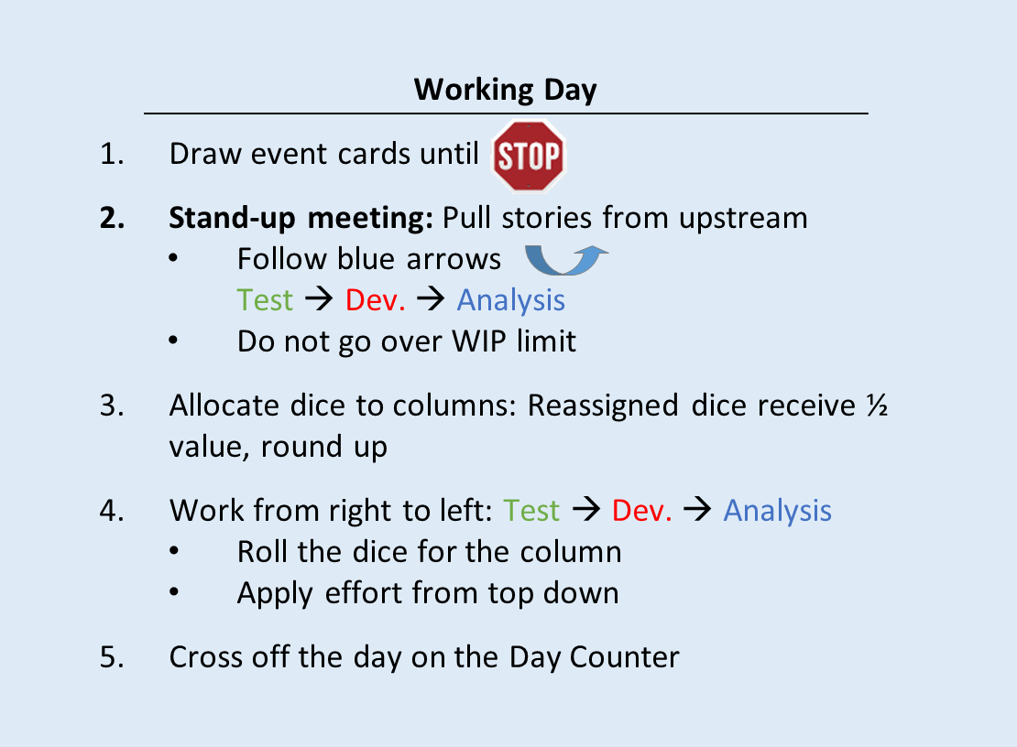
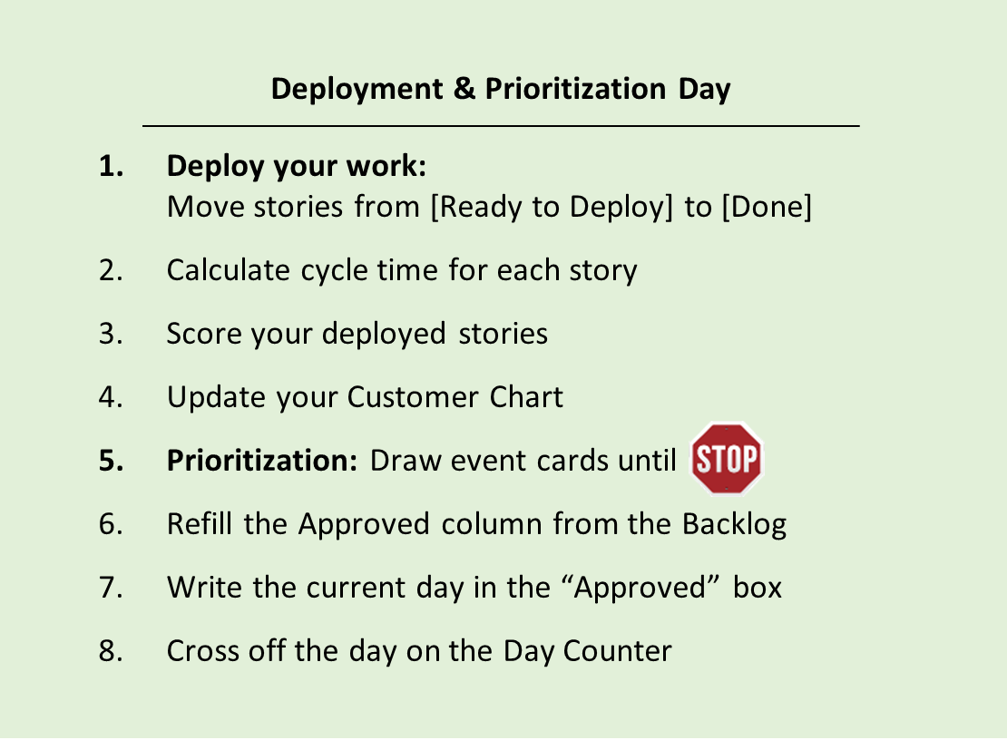
Rule cards

Slide 9
Day Counter
We start the game from day 3
Working Days |  |  | Deployment & Prioritization
1 | 2 | 3 | 4
5 | 6 | 7 | 8
9 | 10 | 11 | 12
13 | 14 | 15 | 16
17 | 18 | 19 | 20
21 | 22 | 23 | 24
25 | 26 | 27 | 28

Slide 10
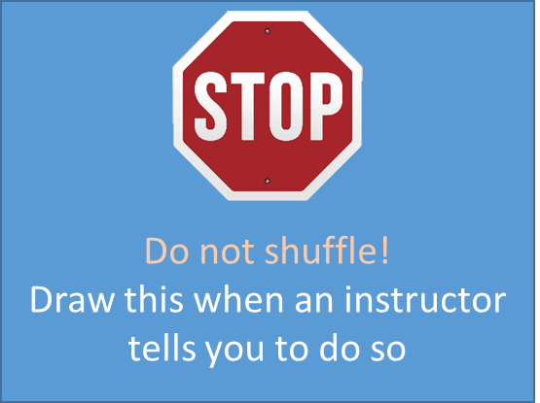
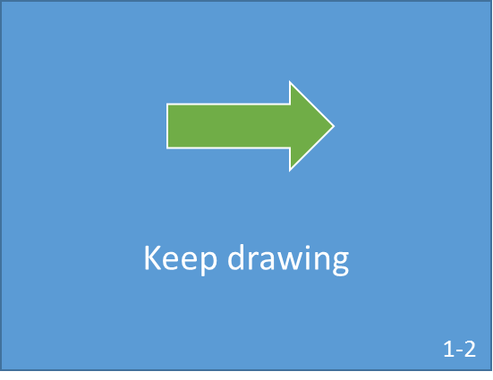
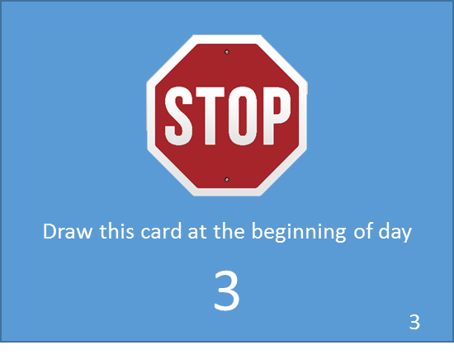



Game setup
Draw 5 event cards
Draw one at a time, until you see another stop sign
Stop here, do not reveal this card

Slide 11
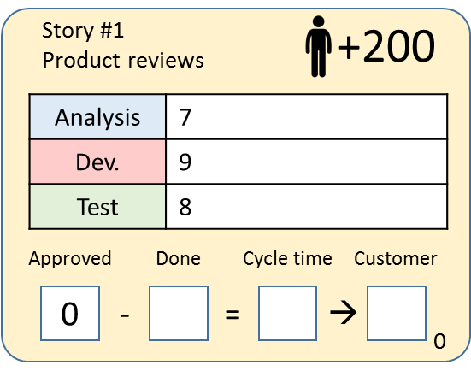
Game setup – Day 3
Prioritization
Deployment
Backlog
Approved
(5)
Analysis
(2)
Dev
(4)
Testing
(2)
Ready to
Deploy
Done
Doing
Done
Doing
Done
Expedited (1)
#1
#2
#3
#4
#5
Cycle Time =Done - Approved
Notes:
Check #ID on the top left of the card & put it according to this diagram

Slide 12
Prioritization
Deployment
Backlog | Approved (5) | Analysis (2) |  | Dev (4) |  | Testing (2) | Ready to Deploy | Done
 |  | Doing | Done | Doing | Done
 |  |  |  |  |  |  |  | Expedited (1)
#1
#2
#3
#4
#5
Cycle Time = Done - Approved

Slide 13
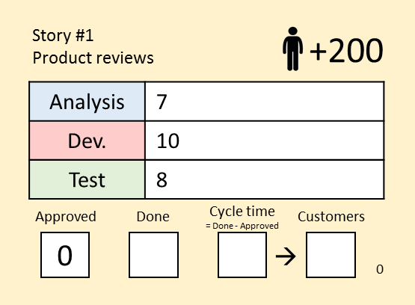
Work item
Card color represents class of service
Story ID
Short description
Expected customers gain
Effort needed from each team (dice rolls)
Created (Day #)
Actual customers gain
When the item is approved, write day # down
When the item is done (deployed), write day # down
Cycle time = Done - Approved

Slide 14
Day 3

Slide 15
Working Day

Slide 16
1. Draw event cards
Draw event cards until a stop sign

Slide 17
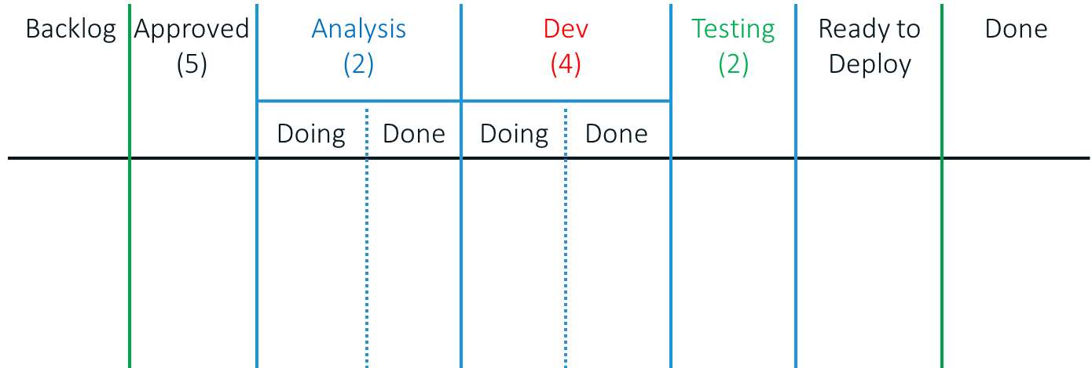
2. Pull stories from upstream
Pull new work from upstream – follow blue arrows
Move items from Approved & Done to the next column
Right to left Test -> Dev -> Analysis
Pay attention to WIP limit
#1
#2
#3
#4
#5

Slide 18

3. Allocate dice to columns
You start the game with:
2 Analysts (Blue dice), 4 Developers (Red dice), 2 Testers (Green dice)
You may reassign dice to other column
Reassigned dice receive ½ value, round up
#1
#3
#4
#2
#5

Slide 19
3. Do the work
Roll dice to get work done
You start the game with
2 Analysts (Blue dice)
4 Developers (Red dice)
2 Testers (Green dice)
Rolling starts from Test -> Dev -> Analysis
Team members get full value of the dice when doing work in their area.
Team members get half value (round up) if used in another area of expertise (e.g. a developer doing testing)

Slide 20
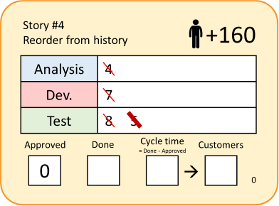


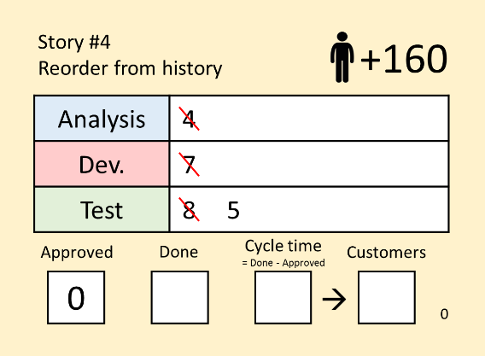

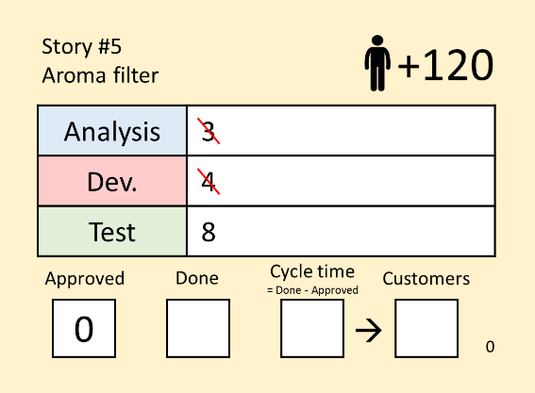
4. Work from right to left
Start rolling from Test first
Roll dice in the column
all at once
Test
(2)
Ready to
Deploy
7
3 / 2 = 2
Spend 5 points to get the testing done
Not their expertise, total dice is halved, round up
7 + 2
= 9
4
Spend the remaining 4 points on the next item
In case there is a remainder = waste
Repeat this with Dev and Analysis
Notes:
Left over = waste

Slide 21
Rules of thumb
You cannot move any work item over the green lines during working days
Work right to left
Pull new work from upstream
Do the work

Slide 22
5. Cross the day off on the Day Counter
Working Days |  |  | Deployment & Prioritization
1 | 2 | 3 | 4
5 | 6 | 7 | 8
9 | 10 | 11 | 12
13 | 14 | 15 | 16
17 | 18 | 19 | 20
21 | 22 | 23 | 24
25 | 26 | 27 | 28

Slide 23
Day 4

Slide 24
Notes:
To Days

Slide 25
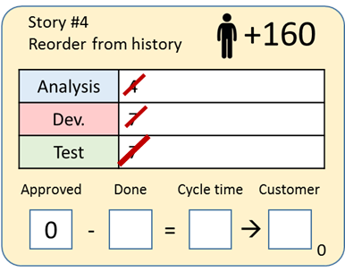
1. Deploy your work
Move items from [Ready to Deploy] to [Done]
Write the current day in the Done box
Ready to Deploy
Done
4

Slide 26
2. Calculate cycle time for each story
Cycle time = Approved - Done
4
4
Cycle time = 4 - 0 = 4

Slide 27
3. Score your deployed stories
Deliver by the deadline or
lose customers
Expedited Items
Fixed Delivery Date
By 3/21
Deliver by the deadline or
earn no customer
Standard
Attract fewer customers if you do not deliver fast enough

Slide 28
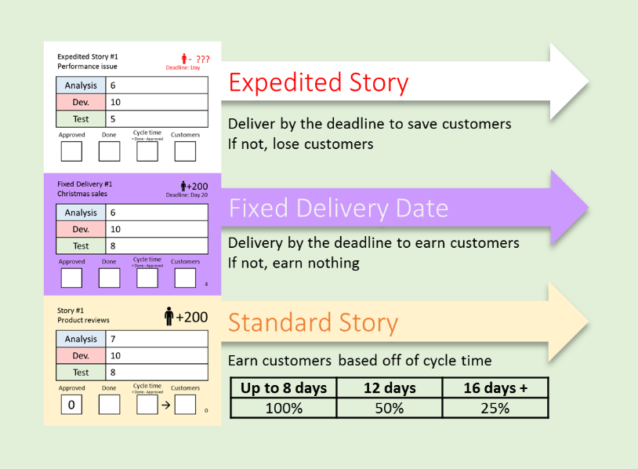
Scoring reference

Slide 29
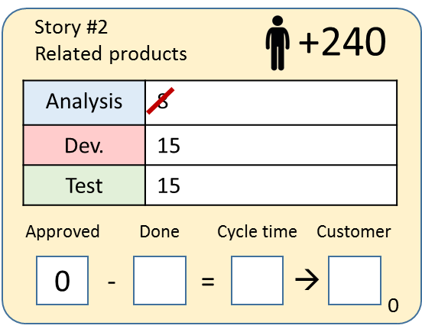
Scoring – Standard Story
Earns customers after deployed, based off of cycle time
4
4
160
< 8 days = 100% Customers
Up to 8 days | 12 days | 16 days +
100% | 50% | 25%
12
12
120
12 days = 50% Customers

Slide 30
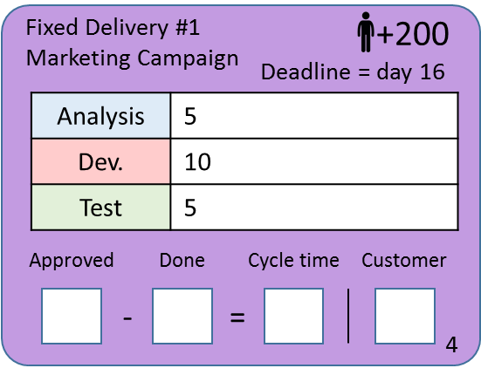
Scoring – Fixed Date Story
Cycle time is irrelevant to customers earned
If you do not finish a fixed date story by the deadline, you earn no customers
You must finish the story anyway

Slide 31
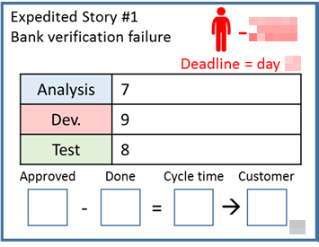
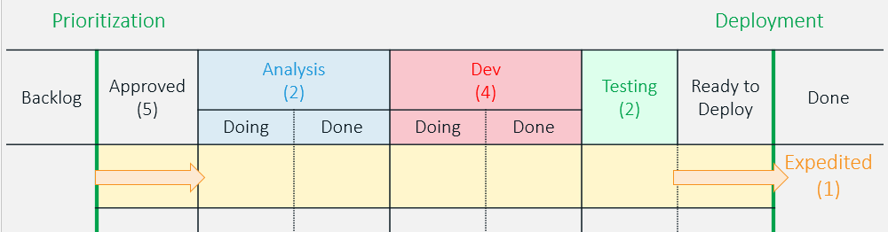
Scoring – Expedited Story
You will lose customers if the issue is not fixed on time
This item uses the expedited lane
Lane WIP limit = 1
Can break column WIP limits
Skip “Approved” & “Ready to Deploy” column (Item does not need to be prioritized + can be deployed to production at anytime)

Slide 32
4. Update your customer chart
Plot a number of customers earned through delivered stories
This accumulates over the course of the game
160

Slide 33
Notes:
To Days

Slide 34
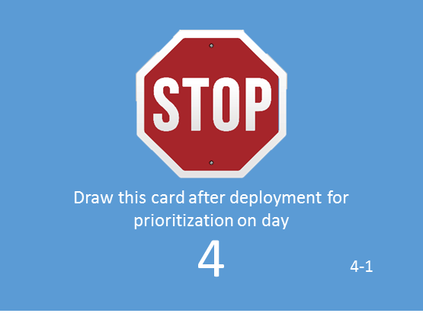
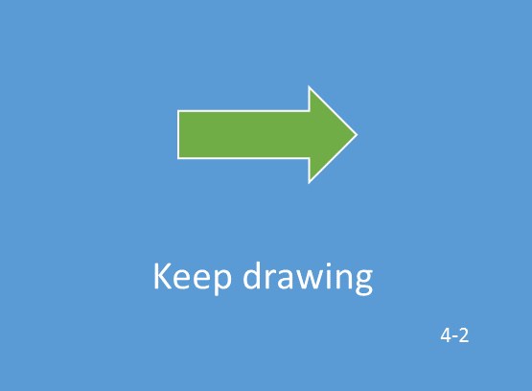
5. Prioritization: Draw event cards
Draw event cards for new stories from customers
Until you see another stop sign
Stories from envelope #0

Slide 35
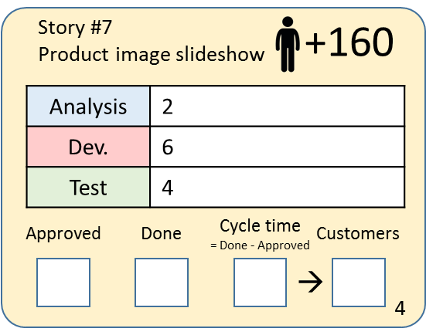
6. Refill the Approved column
Prioritize and refill the Approved column from the Backlog
Also sort top to bottom in Approved column
Prioritization
Approved
(5)
Backlog
Stories from envelope #0

Slide 36
7. Write the current day in Approved box
For items those are approved, write the approved day in the box
4

Slide 37
Day 4 - Prioritization
Spend 5 minutes to organize the standard (yellow) stories and fixed date (purple) stories in the backlog
Now select 5 stories to start with and place these in prioritized order in the Approved column
In each of these stories write ”4” in the field ”Approved”

Slide 38
8. Cross off the day on the day counter
Working Days |  |  | Deployment & Prioritization
1 | 2 | 3 | 4
5 | 6 | 7 | 8
9 | 10 | 11 | 12
13 | 14 | 15 | 16
17 | 18 | 19 | 20
21 | 22 | 23 | 24
25 | 26 | 27 | 28

Slide 39
Day 5

Slide 40

1. Start the day
Draw an event card
Stop once you see another Stop sign

Slide 41
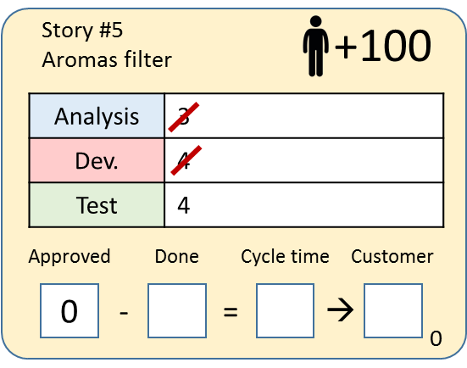
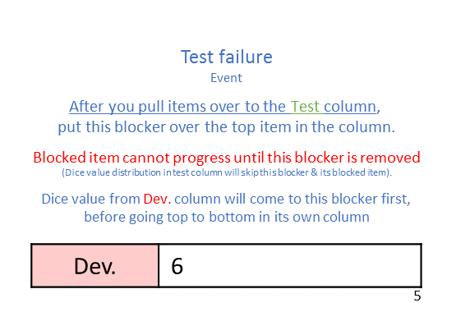
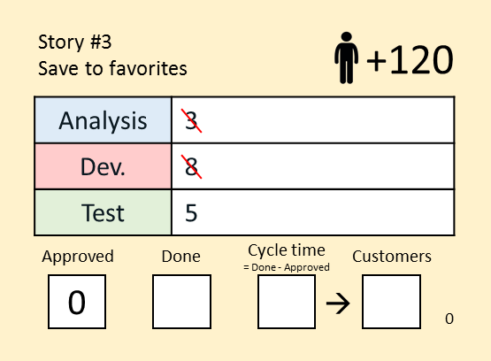
How blocker works
Roll value = 13
Roll value = 4
Dev.
(4)
Test
(2)
Doing
Done
8
1

Slide 42
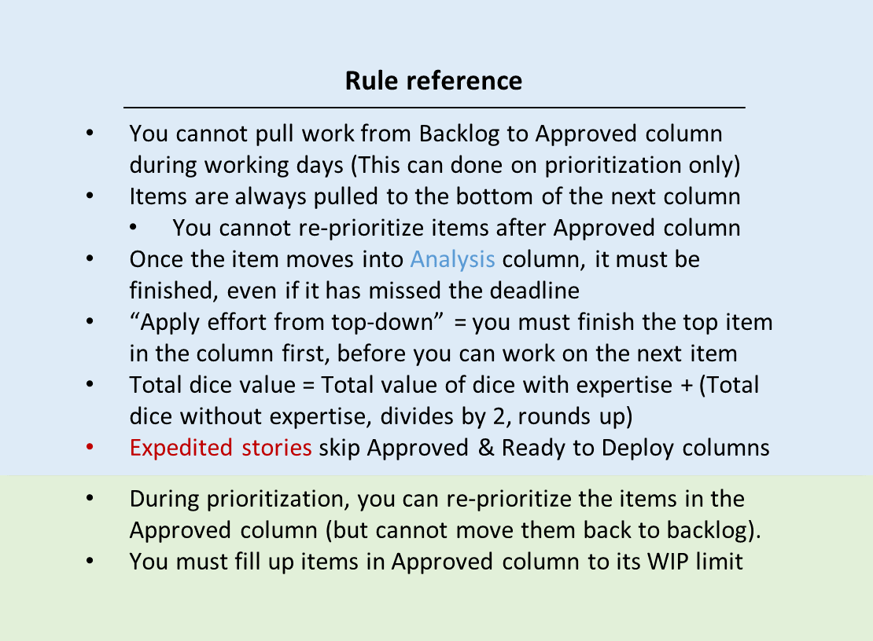
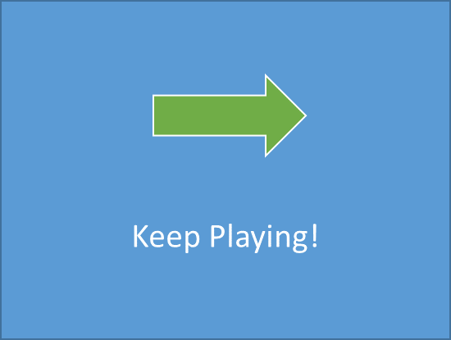

Slide 43
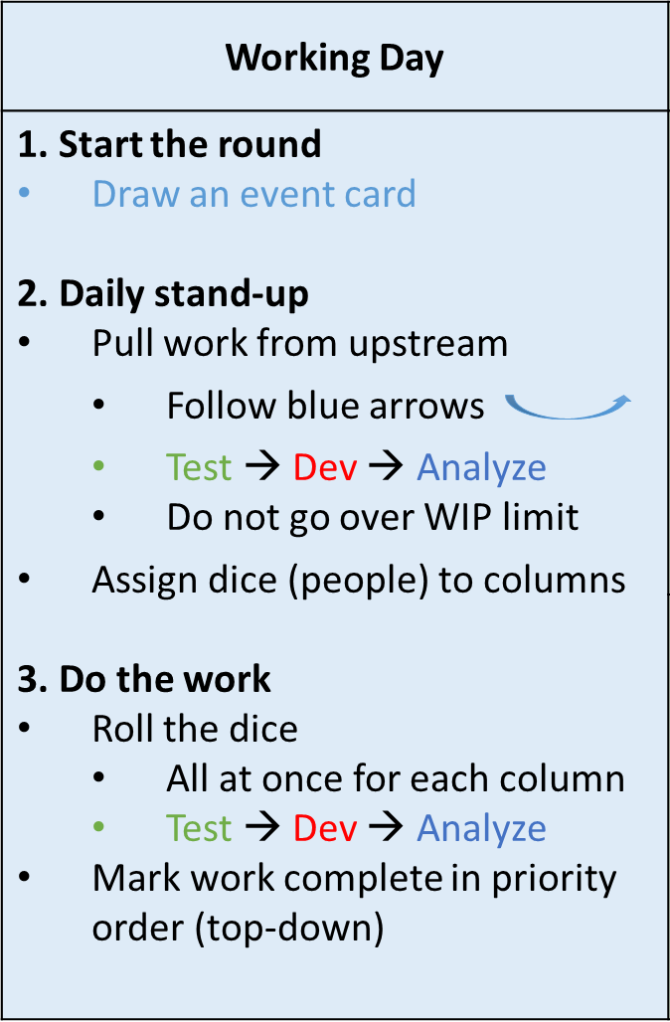

Slide 44
Blocker

Slide 45
Debrief

Slide 46

And our winner for today is…
What is your strategy in this game?
Notes:
We count the score only up to day 20.

Slide 47
Practices
Did you see the 6 Kanban Practices
Visualize workflow
Limit work in progress
Manage flow
Make policies explicit
Implement Feedback Loop
Improve Collaboratively, Explore Experimentally
Notes:
Policies explicit – Rule for classes of service, expedited lane, WIP limit, deployment period, Definition of done = Dice count
Implement Feedback Loop – Feedback like, who to send off to train a new team member
Improve … - Retrospective

Slide 48
Reflection - Prioritization
What does the Approved column represent?
What factors did you take into account for prioritization?
What would happen if you increase WIP limit in Approved column? What about decrease?
Notes:
What does the Approved column represent?
– Top value items + you cannot meet with the business everyday + prevent IT folks to work on low-priority items
What factors did you take into account for prioritization?
Return on Investment = # of customers / total effort
Workload in each column
What would happen if you increase WIP limit in Approved column? Will we get anything done faster?
Not really, but it definitely impacts your score as cycle time is longer
In reality, today we have many items / everything in approved column

Slide 49
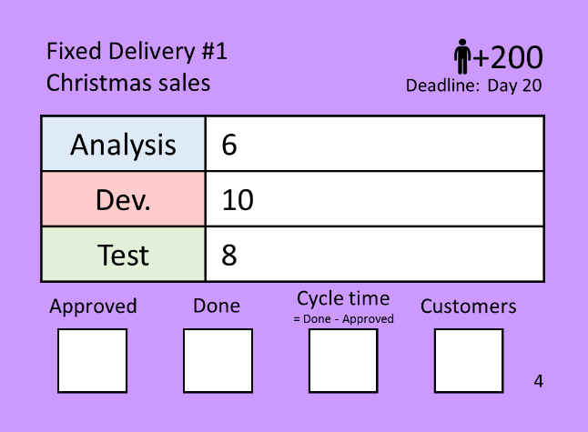
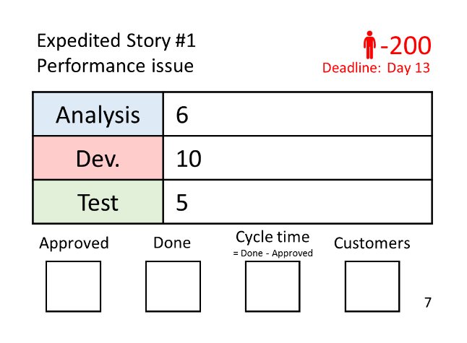
Reflection – Class of service
How did the fixed date items impact the flow?
When did you start those items?
Did you finish it early?
How did the expedite items impact the flow?
What about lost Business Value?
Did you swarm on them?
Notes:
How did the fixed date (round) items impact the flow?
-
When did you start those items? Did you finish it early?
- If you start this too early, it does not give you any bonus while you should spend your time on standard story to finish them faster and get less penalty
How did the expedite items impact the flow?
- It immediately puts everything else on hold. Having this visualized is beneficial for our customers so they can see the impact on what happens when they let this come to the board
What about lost Business Value? Did you swarm on them?
- We simplify negative scoring to make the game easier

Slide 50

Reflection – Collaboration
Did you reassign dice to a different column?
What caused you to do that?
Bottleneck?
Underutilization?
Priority?
Release window?
Notes:
Did you reassign dice to a different column?
- Stand-up meeting will help the team to make this decision
What caused you to do that?
- Column is at WIP – Without WIP, people will still work in their silos - Collaboration
- See workload in each column - People are transparent on what they are doing through Kanban board
- Release window is coming -> shift people from dev to work on test and get it done to gain customers -> Break silos with end-to-end view. Early shipping increases score bonus by a “Sales growth” card
Reality
- That’s why we do stand up meeting so that we can ask each other for help, based off the value of work
-

Slide 51
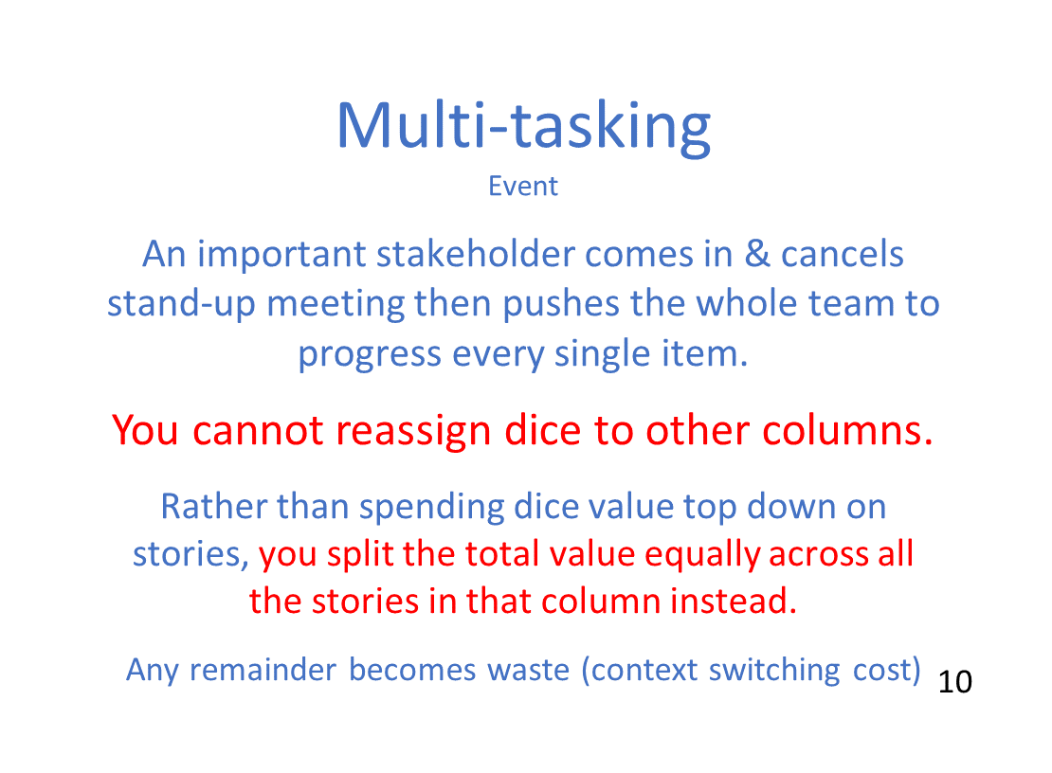
Reflection - Multitasking
What was the impact of this event?
What would happen if this situation continues?
How does it compare to what we are doing today?
Notes:
What was the impact of this event?
- Causes nothing to move to the next column as you try to progress everything at the same time
- Wrong sequence
What would happen if this situation continues?
- Things will progress slower -> Worse cycle time, Miss a bonus chance of 20% customers increase
How does it compare to what we are doing today?
- Today, we are multitasking, start too many things without finish anything. Everyone is working in a silo

Slide 52
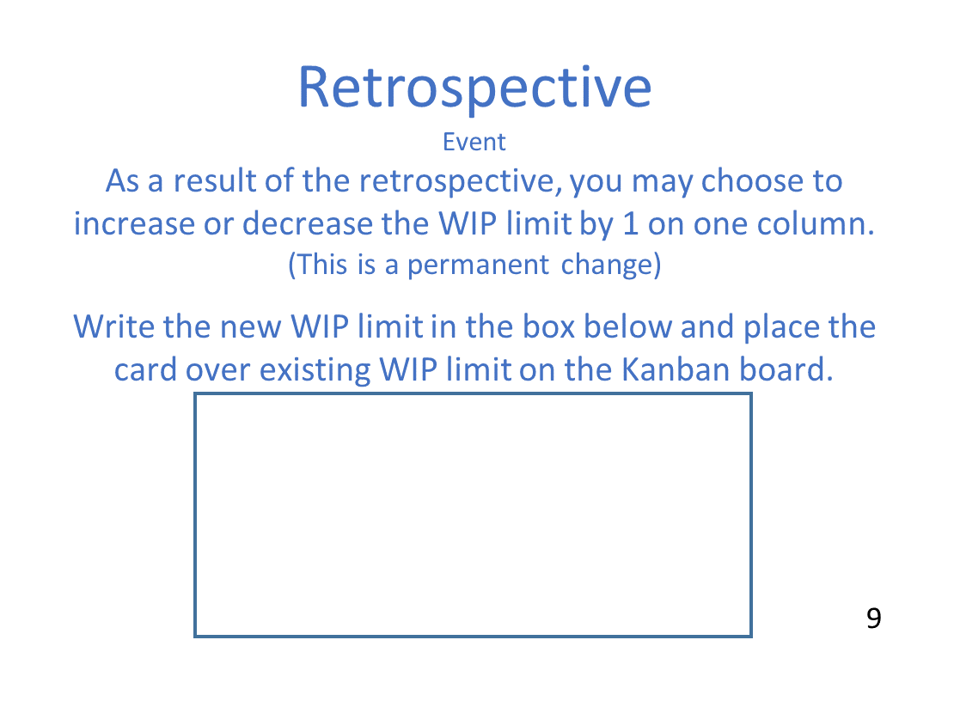
Reflection – WIP limit & Retrospective
What was the impact of introducing the WIP limit?
What did you do in your Retrospective? Does it help?
What would happen if we play this game without WIP limit?
Notes:
What was the impact of introducing the WIP limit?
- Allow you to foresee bottlenecks – Reassign dice to help
What did you do with Retrospective?
- Increase WIP limit – This might help a little bit to allow dice remainders to go to one more item. However, increase this further is not going to help
What would happen if we play this game without WIP limit? Will we get anything done faster?
- Result remains the same because your dice distribution will not reach items at the bottom
- But cycle time will drastically increase since you approve everything -> Reduce WIP in approved column will help
- More WIP = more multitasking

Slide 53
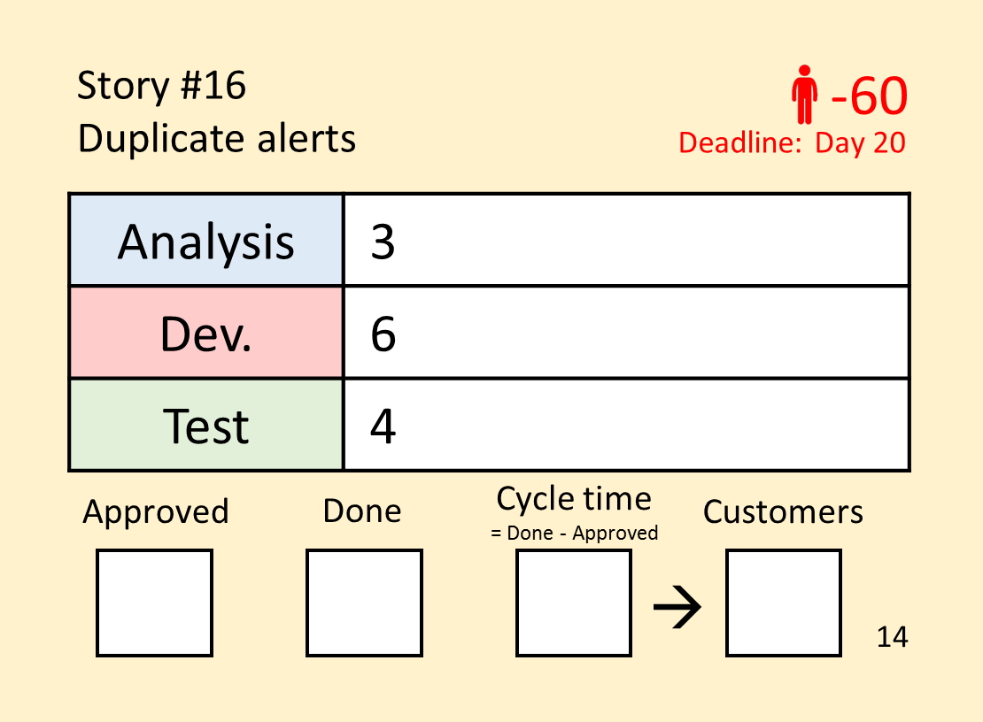
Reflection - Low-priority item
What did you do with this item?
Notes:
What did you do with this item?
- Did you start it immediately? You are not supposed to start low-priority work without going through prioritization first. In reality, you have issues like this coming everyday and we most likely start working on it immediately. That prevents us from focusing on high-priority work and being distracted by low-priority items. The team should wait until business prioritizes the work.

Slide 54
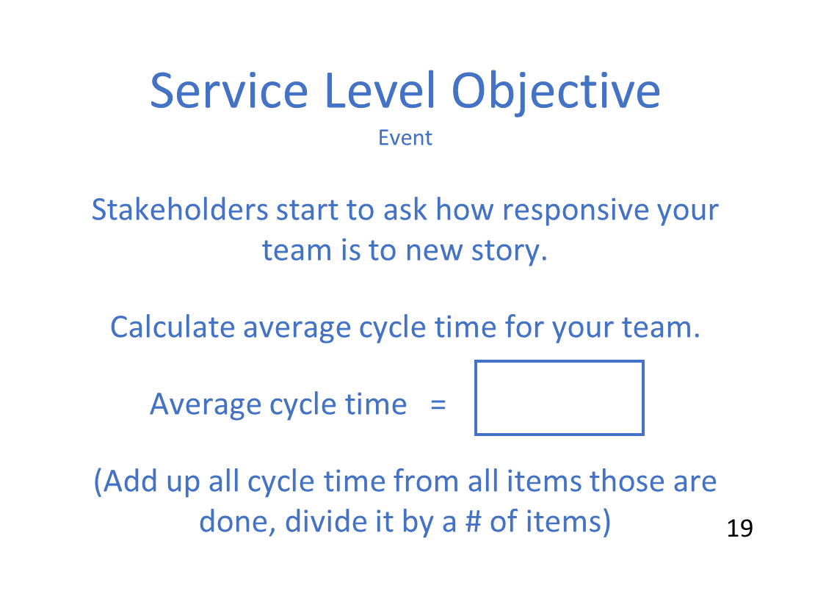
Average Cycle Time
What is your average cycle time?
What does this number tell you?
Notes:
What does this number tell you?
This number allows us to see how long it takes to finish a new item.
This helps us plan when to start “Fixed Delivery date” stories.
Allow team to measure their improvement
See impacts of situation changes (resource change, break-ins, priority swap)
More WIP = Higher cycle time

Slide 55


http://goto/agileyammer
http://goto/joinagilecop

Slide 56
Thank you

Slide 57
Rules for an instructor
When audience asks about what to do with Issue card on day 14, just tell them that it is up to them

Slide 59
Standard Story Scale
Up to 6 Rounds = 100%
9 Rounds = 50%
12+ Rounds = 25%

